Slide 1
SECURE DATA HIDING IN IMAGES USING STEGNOGRAPHY
CAPSTONE PROJECT
Presented By:
Student Name : SHAIK ABDUL SHAHANSHA
College Name : VIGNAN'S LARA INSTITUTE OF TECHNOLOGY AND SCIENCE
Department : MASTER OF COMPUTER APPLICATIONS

Slide 2
OUTLINE
Problem Statement
Technology used
Wow factor
End users
Result
Conclusion
Git-hub Link
Future scope

Slide 3
Problem Statement
Ensuring secure communication of sensitive data is a growing challenge in the digital age. Traditional encryption methods may attract unwanted attention, making covert data transmission essential. This project focuses on developing a steganographic technique to securely hide data within images while preserving image quality and minimizing the risk of detection.

Slide 4
Technology used
Platform used: PYTHON IDLE.
Libraries used:CV2 Library, OS Library, String Library.

Slide 5
Wow factors
Integrating encryption with steganography for dual-layer security, using AI to optimize data hiding, and implementing error correction for data integrity. Additionally, adaptive payload capacity ensures efficient embedding, while blockchain integration enhances access control.

Slide 6
End users
1. Cybersecurity Professionals – To securely transmit sensitive information without detection.
2. Government & Intelligence Agencies – For covert communication and confidential data exchange.
3. Medical Sector – To protect patient records and medical images from unauthorized access.
4. Financial Institutions – For secure transmission of banking and transaction data.
5. Journalists & Activists – To safeguard sensitive information in oppressive environments.
6. Corporate Sector – For securing trade secrets and confidential business communications.

Slide 7
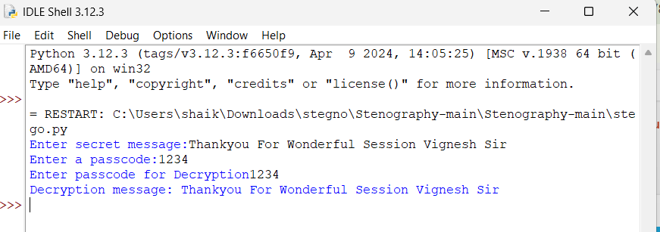
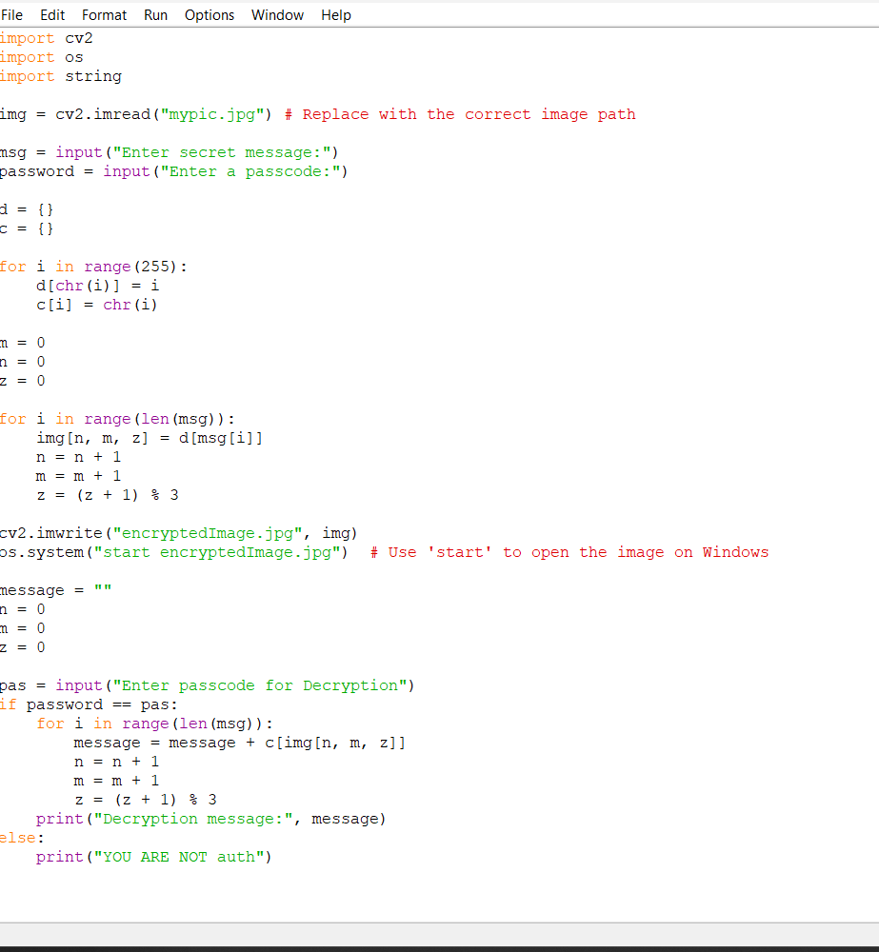
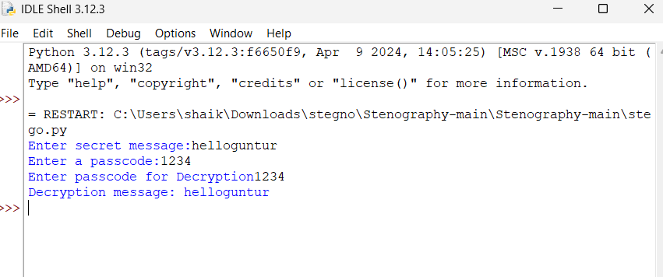
Results

Slide 8
Conclusion
This project enhances secure data hiding using steganography by integrating encryption, AI optimization, and error correction. It ensures high security, imperceptibility, and adaptability while maintaining image quality. The approach benefits various sectors, including cybersecurity and healthcare, by enabling covert communication. Future improvements can focus on higher capacity and resistance to attacks.

Slide 9
GitHub Link
https://github.com/Shaheensha21/AICTE_ProjectCyberSecurity.git

Slide 10
THANK YOU

